Slide 1

HBase Fundamentals with A Practical Use case
Sai Geetha M N

Slide 2
Agenda
What is HBase?
HBase Characteristics
HBase Data Model
HBase Architecture
HBase and Phoenix
A Use case - Challenges and Solutions

Slide 3
What is Hbase?
HBase is a distributed database build on top of the Hadoop distributed file system

Slide 4
HBase
Google Big Table
HBase
Google File System
MapReduce
HDFS
MapReduce
Notes:
It is developed as part of Apache Software Foundation’s Apache Hadoop Project and runs on top of HDFS. It started in 2008 by a company named Powerset. Now it has become a top level Apache Project.

Slide 5
HBase
Distributed
Scalable
Fault Tolerant
Notes:
The data stored is kept as files on HDFS which is distributed
HBase abstracts the files and presents it as columns of data that are retrievable using a row key – an index
HBase is scalable because the amount of disk space available is directly proportional to number of nodes in the cluster
It is fault tolerant because it uses the feature of maintaining 3 replicas on HDFS and hence even if one replica is lost or one node is down, it is able to serve the same data from other nodes. Meta data is managed by having a secondary name node.

Slide 6
Hbase – Important Features
Structured
Low Latency
Random Access
Supports Big Data
Notes:
Structured: It provides a loose data structure. Through the concept of column families and columns – which we see later. It reimagines the layout of unstructured sparse data
It provides low latency access through various means of caching and write buffers. It has real time access to read and update using row-keys
It also allows random access unlike HDFS where it is primarily sequential access. Allows real-time random access to data stored in it
Can work with billions of rows of data where each record can contain millions of fields

Slide 7
HBase: Characteristics
Columnar store
Denormalized Storage
Only CRUD operations
ACID at row level
Notes:
Each of these are elaborated as we go along

Slide 8
HBase: Characteristics
Columnar store
Denormalized Storage
Only CRUD operations
ACID at row level
Notes:
Each of these are elaborated as we go along

Slide 9
HBase: Columnar Store
Relational DB
HBase
A single row
Fixed schema
All values exist or null
Column is an attribute
2 dimensional
Has only
Unique id
Name of column
Value
Id | Column | Value
1 | EmpName | Neil
1 | DOJ | 11-12-2004
1 | Designation | Manager
2 | EmpName | Pete
2 | DOJ | 04-05-2010
EmpId | EmpName | DOJ | Designation
1 | Neil | 11-12-2004 | Manager
2 | Pete | 04-05-2010 | Engineer
Notes:
(irrespective of how much data) It has only these attributes:
The unique identifier is called row key
The number of rows in Hbase is equal to the number of attributes in RDBMS table.
Every column becomes one row
Columns EmpName, DOJ are called column qualifiers
Logical Rows not Physical rows
Flexibility on what column it stores
Column Qualifiers

Slide 10

Advantages
Sparse Tables – no wastage of space
Dynamic Attributes – Can add any number of attributes
Notes:
Adding columns w.r.t to employee onsite or on maternity leave etc. – all have columns but no values.
Cell occupy space
Sparse tables are wasted storage in RDBMS
Here – only adding an extra row to the existing column to dynamically add attributes to the table – without changing the schema
Allows a totally powerfulway of storing data

Slide 11
HBase: Characteristics
Columnar store
Denormalized Storage
Only CRUD operations
ACID at row level
Notes:
Stores data in denormalized way.
RDBMS has 1st, 2nd and 3rd Normal form – minimizes redundancy, optimizes for storage.
Give an example of normal data structure in a RDBMS – rows versus columns

Slide 12
De-normalized Storage
Storage is cheap in a distributed system
Optimize number of disk seeks
Hence denormalize – putting all data into a single table
Allows complex data types in a single cell
A single read gets the entire data
Notes:
Storage is cheap as we use commodity servers for the cluster.
RDBMS use normalized forms to minimize redundancy.
Distributed systems optimize for number of disk seeks
Employee Details
Employee Subordinates
Employee Address
3 separate tables
Logical unit or semantic unit of data
But storage is cheap in a distributed system
One disk seek will give all information about an employee
Array
Struct

Slide 13
HBase: Characteristics
Columnar store
Denormalized Storage
Only CRUD operations
ACID at row level
Notes:
Each of these are elaborated as we go along

Slide 14
Only CRUD Operations
No SQL
Does not support SQL - No Joins, No Group By, No Order by
CRUD only - of a cell or a row
No operations involving multiple tables
No Indexes
No Constraints (Null, PK, FK)
Notes:
That is why all details needed for an entity is self-contained

Slide 15
Sample Hbase Operations

Slide 16
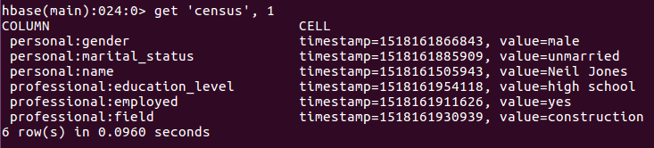
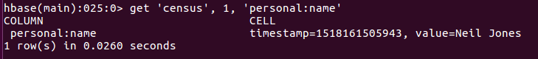
Sample Hbase Operations

Slide 17
HBase: Characteristics
Columnar store
Denormalized Storage
Only CRUD operations
ACID at row level
Notes:
Each of these are elaborated as we go along

Slide 18
ACID at row level
Updates to a single row are atomic
Updates to multiple rows are NOT atomic

Slide 19
Then Why HBASE?
HDFS
Append-only
Full Table scan, partition scan
HBASE
Random Write, bulk incremental
Random read, small range scan
Write Pattern
Comparison
Read Pattern
Structured Storage
Hive (SQL) Perf
Max Data Size
4-5x Slower
Do it yourself
30+ PB
sparse-column family data model
~ 1 PB
Very Good

Slide 20
HBase Data Model

Slide 21
Data Layout – 4 Dimensional Model
Row Key
Column Family
Column
Timestamp

Slide 22
4-dimensional Data Model
Column Family
Column Family
Row Key
Column
Column
Column
Column
Column
Timestamp
Value
Timestamp
Value
Timestamp
Value
Notes:
4 dimensional data
Row Key
Column Family
Logically related Group of columns grouped together
When created and initialized
Hard to change
Column
Don’t have to specify up front
Can be any number
Do not have to have values
Timestamp
All versions are preserved
Latest timestamp returned

Slide 23
Employee Data
Official
Personal
EmpId
Department
Designation
WorkLevel
Name
Address
Timestamp
Engineer
Timestamp
Senior Engineer
Notes:
What will be returned is senior engineer
A version is actually the timestamp at which the data was edited

Slide 24
Row Key
Uniquely identifies a row
Can be primitives, structures or arrays
Represented internally as a byte array
Sorted in ascending order
Partitions into subsets called regions (based on sorted data)

Slide 25
Column Family
All rows have the same set of columns families
Each column family is stored in a separate data file
Set up at schema definition time
Can have different columns for each row
Columns can be dynamically added

Slide 26
Column
Columns are units within a column family
New Columns can be added on the fly
Column Identification is done this way: ColumnFamily:ColumnName

Slide 27
Timestamp
Used as the version number for the values stored in a column
The value for any version can be accessed
It is calculated based on epoch time – since Jan 1st 1970

Slide 28
HBase Architecture
Notes:
This part talk about how the computing is done inside an Hbase cluster

Slide 29
Architecture
HFiles
HDFS
Disk
Notes:
Distributed DB
Reliability by Hadoop
Hfiles
Splits flies into blocks and replicates 3 times

Slide 30
Region Servers
HFiles
Notes:
Client access is provided by Servers designated as Data nodes in the HBase cluster
And each data node is responsible for giving access to different parts of data called regions
These data nodes are also called region servers

Slide 31
Schema Changes
Cluster Management
Data Administration
Datanode 4 down
Master Servers
Zookeeper
Reassign
Region Servers
Notes:
Centralized node is the Master Node
Clients go to fetch their data
Master – HMaster – Active-Passive for failover
At any one point only 1 is active
Zookeeper
1. Coordinate between the various servers and provide centralized configuration
2. Keeps a session based connection with each server and the servers send heartbeats so that the zookeeper knows that they are still running. And it can send notifications to other nodes if a node becomes unavailable
3. The master will keep hearing for zookeeper notifications. If one of the worker node goes down, it will reassign to the other nodes.
4. The passive master also keep listening to zookeeper notifications and so if master goes down it can take over
High availability of data is provided by HDFS
Hive availability of compute is provided by zookeeper
Zookeeper is critical to give HA and hence it itself has failover mechanism by having at least 3 servers

Slide 32
HFiles and Regions
Notes:
This part talks about how data is stored inside an Hbase cluster

Slide 33
RowKey | Input | Forecast
2005|123456|12-01-2017
2005|123457|12-01-2017
2006|123456|12-01-2017
2006|123457|12-01-2017
2007|123456|12-01-2017
2007|123457|12-01-2017
2008|123456|12-01-2017
Region 1
Start key = 2005..
End Key = 2006..
Region 2
Start key = 2007..
End Key = 2008..
Partitions Horizontally
Notes:
Hbase distributes its data horizontally partitioning it into regions
Tables will have one or more regions
Rows within a region are ordered by row key and
Start key and end key exist for each region to define its limits
They get split to further as the data grows into more regions
Each region is accessible only from a single region server
However there can be many regions on one server
Physically on disk, regions are split again. HBase does not store all the data in a region in a single file
It splits the rows vertically by column family – so a single hfile consists of data for a single column family for one region for one table.

Slide 34
HBase Reads
Data block 0
Data Block 1
Data Block 2
…
Data index
Trailer
Hfile Index
Notes:
Rows in an hfile are stored sorted by row key
And the hfile has an index which operates like a B-plus tree which makes it very efficient retrieval of rows
Region servers keep those Hfile indexes in memory
So, when you read data, the server scans the index to find which block to read
When the disk gets read, Hbase knows which block to go to get the data it needs
So, look up happens in memory and the disk reads are minimized

Slide 35
HBase Writes
RowKey | P:name
0000
0123
0345
put ‘emp’, ‘personal:name’, ‘Ben’, ‘professional:role’, ‘Manager’
MemStore – write buffer
Hfile – disk store
Notes:
When you write to Hbase, the region server batches writes in a memory buffer
And flushes them to a hfile when the buffer gets full
The memory buffer gets sorted by row key so that when it gets flushed to hard disk it makes fast sequential writes
The write buffer is called the MemStore

Slide 36
Hbase Reads
get ‘emp’, ‘0123’
BlockCache – read cache
b6
MemStore – write buffer
b8
b2
b6
b8
Hfile – disk store
b2
Notes:
The region server also also uses a read cache called the Block cache so that frequently read data is kept in memory
When you read data – data could split across these components
It could be in recently read data in the Blcok cache or it could be in the recently updated data in the Memstore
Or it could be in the old data that is persisted on the disk
Hbase scans in that order and merges the data into a single result

Slide 37
Cache Management - Compactions
Block Cache – read cache
MemStore – write buffer
Hfile – disk store
Notes:
Hbase actively manages the various stores evicting least recently used cells from the cache and buffering those writes to Hfiles.
Because the buffering can result in many small Hfiles, Hbase compacts them into larger ones for improved read access
You can make further improvements with manual compactions

Slide 38
put ‘emp’, ‘personal:name’, ‘Ben’, ‘professional:role’, ‘Manager’
MemStore – write buffer
Hfile – disk store
b8
WAL – Write Ahead Log
Notes:
Because of the buffered writes, if a region server goes down, you could lose any data that are in memstore and are not persisted to the disk
So Hbase persists all the writes in another persistent store called the ‘Write Ahead Log’
When the region server comes online, it scans the WAL for any writes that have been buffered and have not been flushed and it persistes it to Hfiles before it makes the region available

Slide 39
Master Servers
Zookeeper
Region Servers
Notes:
So, if one of the data nodes suffers an outage, the regions that it is serving will be unavailable for reading or writing until another datanode has been allocated that region and flushed any pending writes in the WAL
Zookeeper and master node take care of the automatically whilst there is a short period where data is not available

Slide 40
Programmatic Access

Slide 41
Different Ways to Connect
Client API in Java
Thrift
REST API
Apache Phoenix
Hive
Notes:
Client API in Java
Configuration object (hbase-site.xml)
Connection
Administration object – table level actions
Manipulate table
Batch operations

Slide 42
Hbase Thrift or REST API
Web Application
Cluster Boundary
Thrift/REST Gateway
Thrift/REST Gateway
HBase Client
HBase Client
HBase
HDFS
Notes:
There are various way to access and interact with Apache HBase. Most notably, the Java API provides the most functionality. But some people want to use HBase without Java.
hose people have two main options: One is the Thrift interface (the more lightweight and hence faster of the two options), and the other is the REST interface (aka Stargate).
A REST interface uses HTTP verbs to perform an action. By using HTTP, a REST interface offers a much wider array of languages and programs that can access the interface.
Thrift is a software framework that allows you to create cross-language bindings. In the context of HBase, Java is the only first-class citizen. However, the HBase Thrift interface allows other languages to access HBase over Thrift by connecting to a Thrift server that interfaces with the Java client
For both Thrift and REST to work, another HBase daemon needs to be running to handle these requests. These daemons can be installed with the hbase-thrift and hbase-rest packages.

Slide 43
Hbase And APACHE Phoenix

Slide 44
What is Apache Phoenix?
A relational database layer on HBase

Slide 45
Apache Phoenix is/has
Query Engine
Transforms SQL Queries into native HBase API Calls
Pushes as much as possible to the cluster for parallel processing
Metadata Repository
Typed access to data stored in HBase tables
JDBC Driver
provides JDBC driver and hence accessible in a standard way

Slide 46
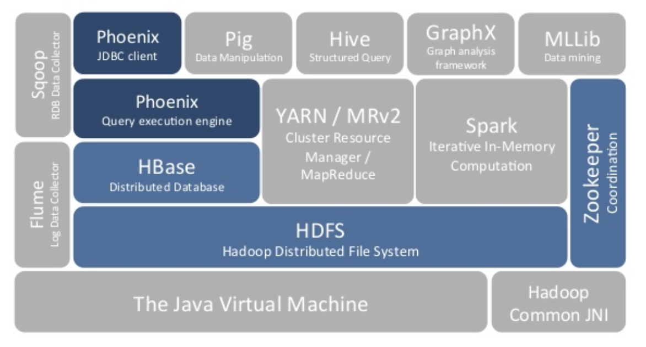
Where Does Phoenix Sit in?

Slide 47
Features Supported
Phoenix Puts the SQL back into NoSQL
Supports Joins, SubQueries, Derived Tables
Three different Secondary Index types
Statistics driven parallel execution
Tracing and metrics for monitoring

Slide 48
Connecting to Phoenix
Phoenix Shell – sqlline.py
SQL clients like SQuirreL, DBVisualizer, Toad etc.
JDBC/ODBC

Slide 49
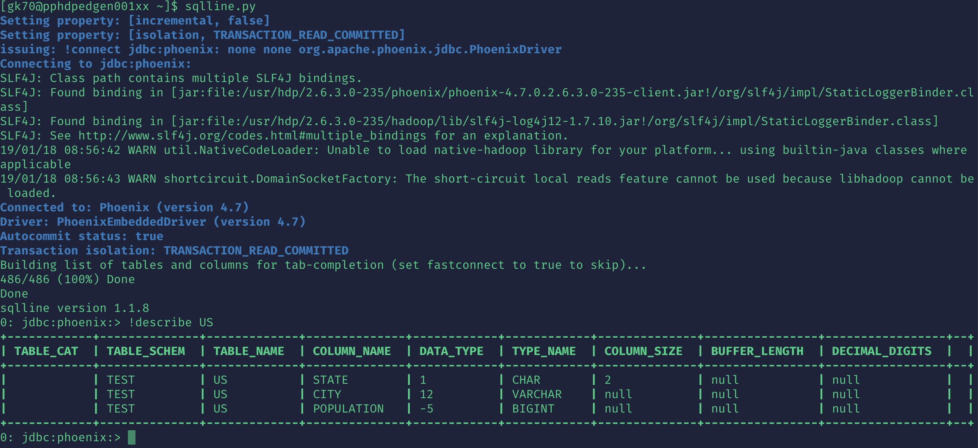

Slide 51
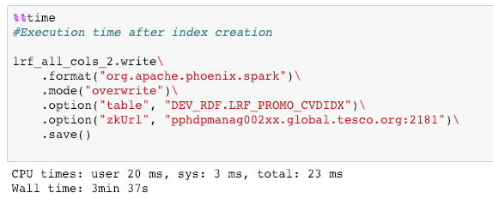
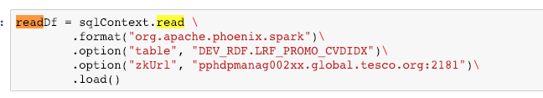

Slide 52
Retail Demand Forecast Use case

Slide 53
RDF Requirements
New 1.2 billion records generated 3 times daily
One output can override the previous output
Small data sets to be returned through APIs within sub-seconds
Small data sets to be updated through APIs all through the day
Data returned through APIs has to be consistent with the updates

Slide 54
RDF Design
Ingest
Sqoop
XCOM
Denormalize
Historical Data
Incremental Data
Data Preparation
Cleanse Data
Data Cubes
Algorithm
Execute
Save on HDFS
APIs
View
Update
Random Access

Slide 55
Options Evaluated
Maria DB
Kylin
Druid
Cassandra
HBase
Notes:
We went with Hbase while Cassandra and Hbase were close contenders

Slide 56
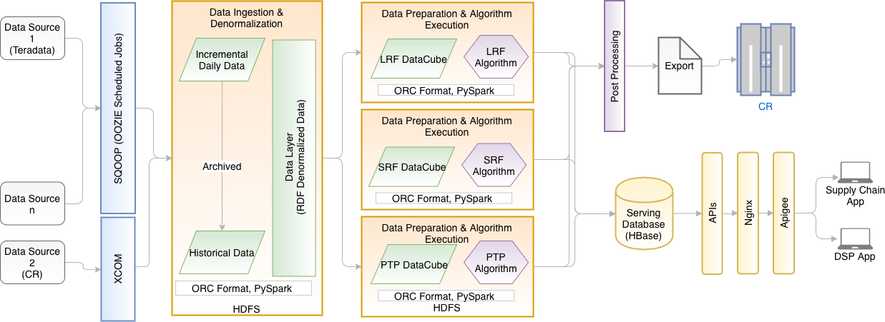
RDF Architecture
Notes:
So, finally the RDF architecture looks like this
Hbase was chosen as part of the Data Layer for serving out APIs

Slide 57
What Was Our Design?
 | FA |  | IFA
Date, Store, Product | Subgroup | … | Forecast | …
Key was Store, Product, Date
Data was totally denormalized
2 Column Families – Frequently Accessed and Infrequently Accessed
Input: 50 columns
Output: 10 Columns
Very Short Column family names and column names
Data in each cell was a few KBs

Slide 58
What Went Well?
Random Reads were supported
Random Updates were supported with row level consistency

Slide 59
Challenges Faced
Read Performance for 1.2 Billion records, ran into minutes
Write ran into several hours
Performance was not consistent/predictable

Slide 60
Improving Write Performance

Slide 61
How did we improve WRITE Performance?
Created Table with Buckets/predefined number of regions upfront
32-64 regions gave the optimum result for 1.2 billion records
16 Regions were optimal for 4 million records

Slide 62
NO. Of Regions
The number of regions were determined in 2 different ways.
For small size data, we went with trial and error on the minimum, maximum and optimum number of regions
For a very large data set, we let the Hbase split by itself when the first time write happens – Which may take long. But we used that as the baseline number of regions to fine tune it further

Slide 63
Consistency in Performance
Needed to create a dedicated “Region Server Group”

Slide 64
Imrpoving READ Peformance

Slide 65
Select the right Row Key
Right Selection of the RowKey – selected through EXPLAIN PLANS
Ex. TPNB, YRWEEK - key, Full table scan
| CLIENT 10-CHUNK 0 ROWS 0 BYTES PARALLEL 10-WAY FULL SCAN OVER DEV_RDF:LRF_PROMO_CVDIDX | | SERVER FILTER BY (ID LIKE '%|201701' AND FA.PGDC = 'H') | | SERVER AGGREGATE INTO DISTINCT ROWS BY [FA.PGDC] | | CLIENT MERGE SORT |
Change key: YRWEEK,TPNB
| CLIENT 10-CHUNK 3946787 ROWS 3145728221 BYTES PARALLEL 10-WAY RANGE SCAN OVER DEV_RDF:LRF_PROMO_CVDIDX_YRWKBPN [0,'201701'] - [9,'201702'] | | SERVER FILTER BY FA.PGDC = 'H' | | SERVER AGGREGATE INTO DISTINCT ROWS BY [FA.PGDC] | | CLIENT MERGE SORT |

Slide 66
Create Indexes
Created covered indexes over the often queried parameters
CREATE TABLE LRF (
YWN VARCHAR NOT NULL,
BPN INTEGER NOT NULL,
FA.PSGC CHAR(5),
…..
FA.TS TIMESTAMP CONSTRAINT PK PRIMARY KEY(YWN,BPN))
SALT_BUCKETS = 16,BLOOMFILTER='ROW';
CREATE INDEX LRF_SUBGRP_CVDIDX ON LRF (PSGC) INCLUDE(YR,WK,….,PGC);
Notes:
There are 3 types of Indexes, Global, Local and covered. Each works for a specific case and based on your case you have to choose the right index

Slide 67
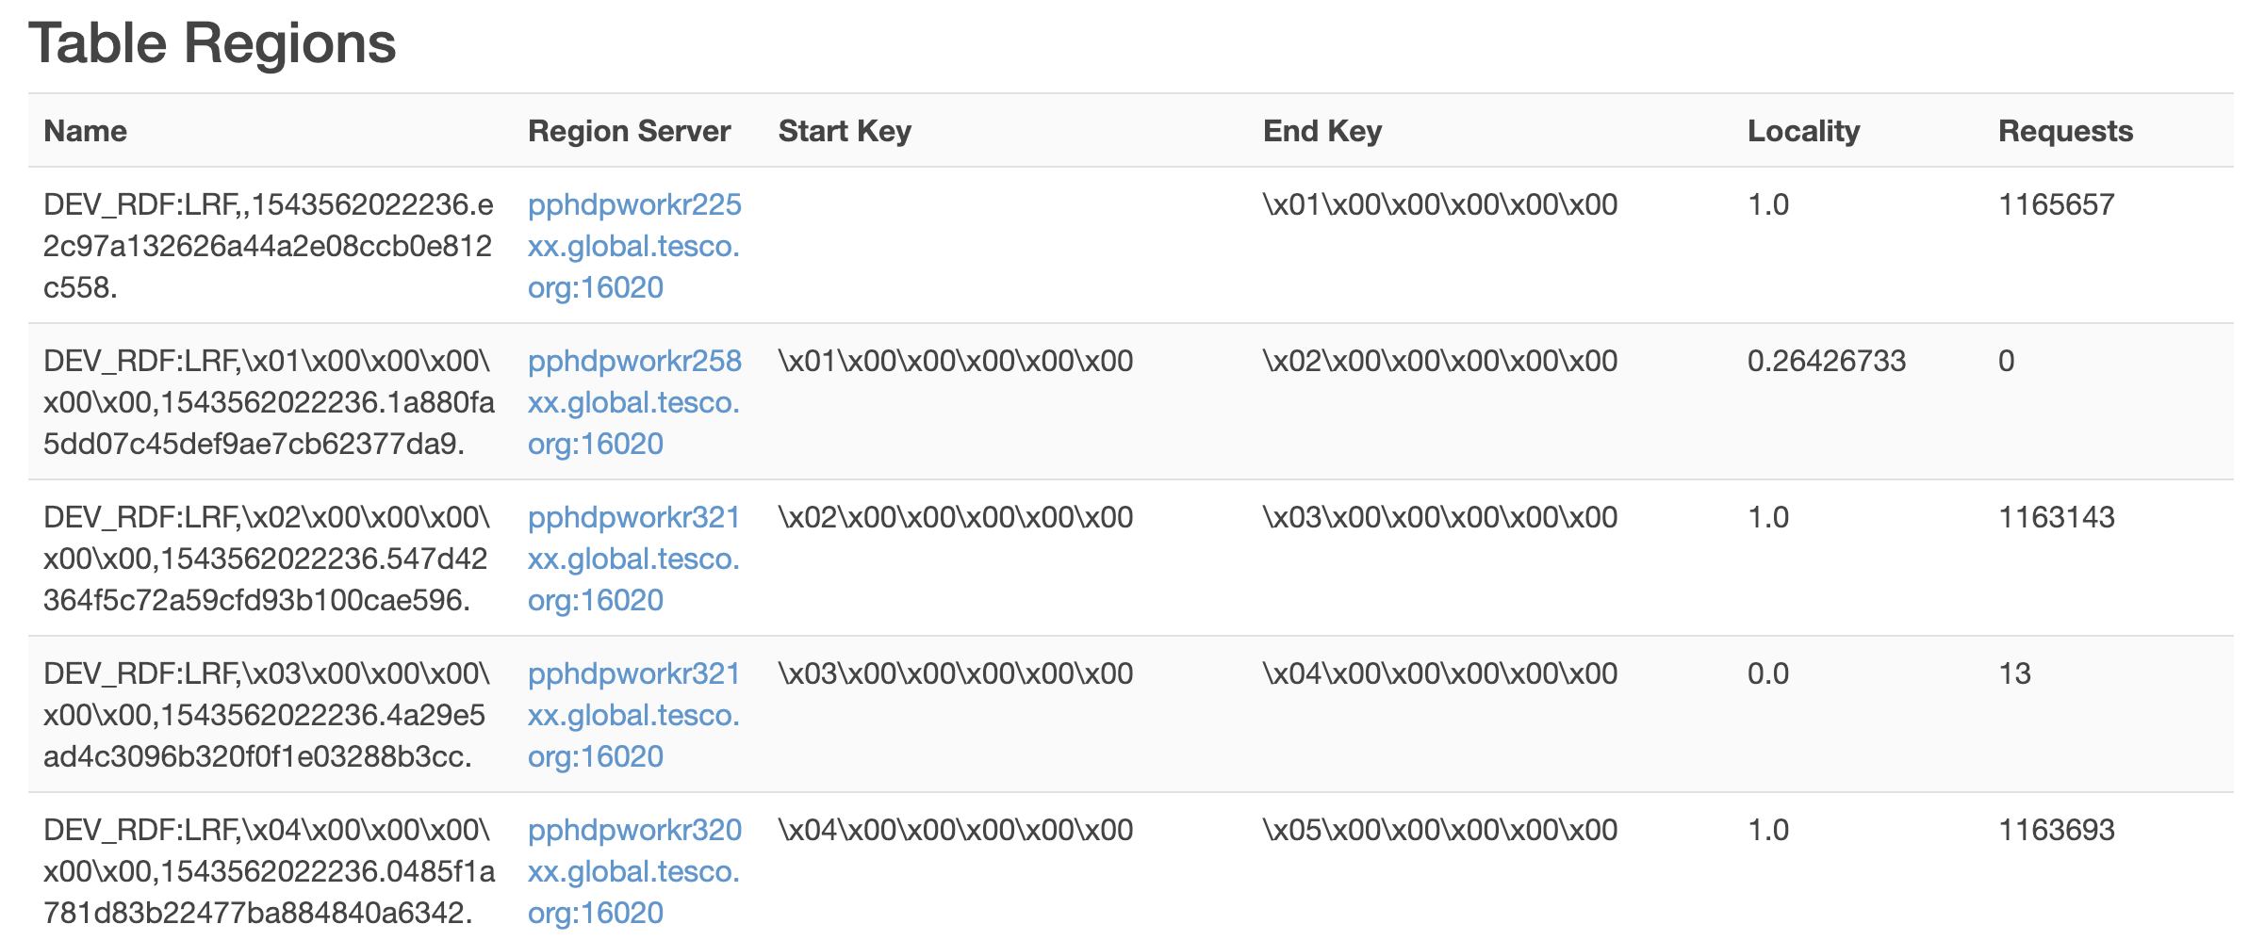
Ensure Data LOCALITY
Ensured Data Locality through Major Compaction after every full re-write
Notes:
After a huge amount of data is written to the table, the data locality could be lost. Hence run a major compaction to ensure that the data locality becomes 1. i.e the data for a particular region is in the same region server that serves that data

Slide 68
Check on Data Compression
Snappy compression gave good performance in off-peak times. It degraded in peak hours. Hence we did not use any compression

Slide 69
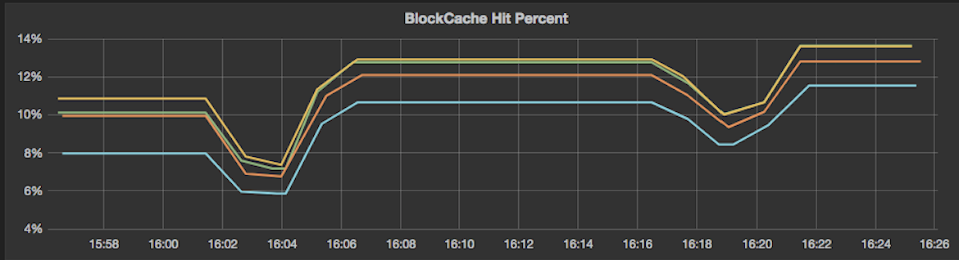
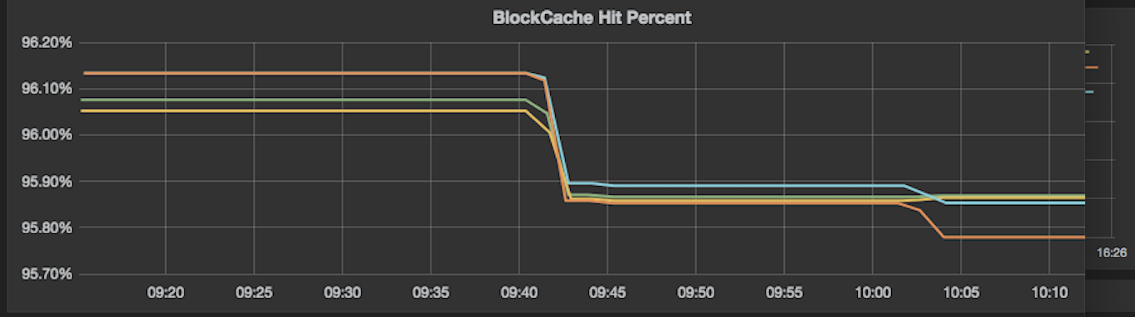
Check the cache Hit ratio in Grafana
Used a row based bloomfilter to improve the cache hit ratio in Block Cache

Slide 70
UPDATE Stats
Run “Update Stats” after a large overwrite or update leads to better performance
Notes:
The UPDATE STATISTICS command updates the statistics collected on a table. This command collects a set of keys per region per column family that are equal byte distanced from each other. These collected keys are called guideposts and they act as hints/guides to improve the parallelization of queries on a given target region.

Slide 71
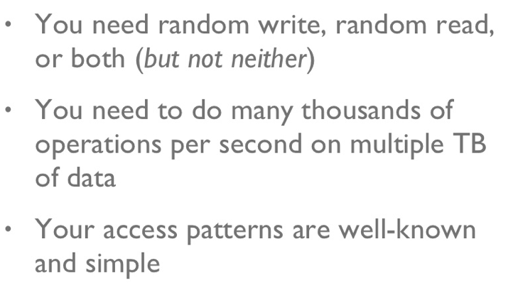
When to use HBase

Slide 72


Slide 73
THANK YOU!

